Slide 2
Jesus, Peter, and the Church
Matthew 16:13-20

Slide 3
Context
First time someone affirms Jesus as Christ (Matt. 16:16; 1:1, 16)
First time Jesus plainly states His intentions (Matt. 16:21)
First time Jesus outlines the conditions of discipleship (Matt. 16:24-27)
All of this is confirmed by Jesus’ transfiguration (Matt. 17:1-8)

Slide 4
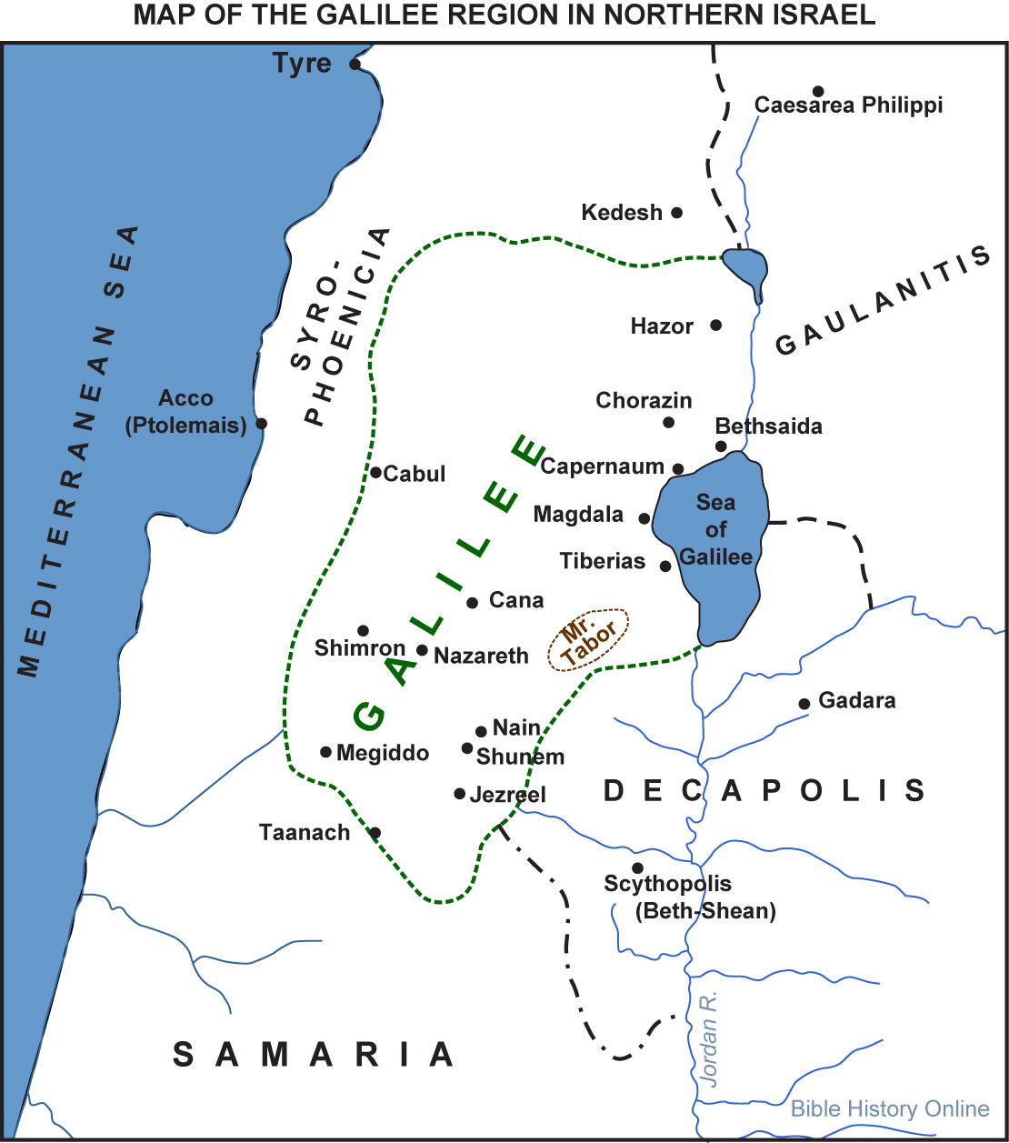

Slide 5
Background: Isaiah 22:15-25
God is warning Judah of Assyrians’ approach and invasion (Isaiah 21-22) – 701 BC
Wicked Shebna will be replaced by faithful Eliakim as King Hezekiah’s household steward

Slide 6
Office of the Steward
In charge of the royal household (Is. 22:15)
Authority to act on the king’s behalf (Is. 22:21-22)
Compare Joseph’s leadership under Pharaoh (Gen. 41:40-44) – aka Egyptian “vizier”

Slide 7
Office of the Steward
This vizier used to report every morning to the Pharaoh and receive his instructions. He saw to the opening of the “gates of the royal house,” that is, of the various offices of the palace, and then the official day began. All of the affairs of the land passed through his hands, all important documents received his seal, all the officials were under his orders. He really governed in Pharaoh’s name and acted for him in his absence. This is obviously the dignity which Joseph exercised, according to Genesis. He had no one above him except Pharaoh, and he was appointed over the whole land of Egypt; he held the royal seal (Gn 41:40-44), and to describe his dignity the Bible says that the Pharaoh “put him in charge of his house;” he made him, in fact, his master of the palace (Gn 41:40; 45:8) …Every morning “the vizier will send someone to open the gates of the king’s house, to admit those who have to enter, and to send out those who have to go out.” (De Vaux, Ancient Israel, 130)

Slide 8
Office of the Steward
Highest official in the nation, second only under the King himself
King’s right-hand man
Administered affairs in the King’s name
Jotham ruled under his father Uzziah (2 Kings 15:5)
Shebna will be replaced by Eliakim (Is. 22:19-23)

Slide 9
Isaiah 22 | Matthew 16
Both are texts commissioning a new leader (Eliakim / Peter)
Both are based on play on names (“pun”)
Eliakim = “God will place” (Is. 22:23, 25)
Peter = “rock” (Matt. 16:18)
Both involve dwelling foundations – tent peg / rock

Slide 10
Isaiah 22 | Matthew 16
Both are texts commissioning a new leader (Eliakim / Peter)
Both are based on play on names
Both grant the leader special authority (Is. 22:22; Matt. 16:19):
Given “keys”
Over the “house of David” / “kingdom of heaven”
To “open and shut” / “bind and loose”
Contrast Pharisees / scribes (Matt. 23:13; Luke 11:52)

Slide 11
Isaiah 22 | Matthew 16
Both are texts commissioning a new leader (Eliakim / Peter)
Both are based on play on names
Both grant the leader special authority (Is. 22:22; Matt. 16:19):
King Jesus is commissioning Peter (and rest of apostles) to lead as His royal stewards over His royal household, the church

Slide 12
Jesus is the Rock of the Church
Those who believe in Him compose the church (Rom. 9:32-33)
He is the only means of salvation (Acts 4:11-12)
We must be careful how we build (1 Cor. 3:10-11)
Our identity is found in Jesus (1 Peter 2:4-8)

Slide 13
Peter is the Rock
To him was given the keys of the kingdom:
For Jews (Acts 2)
For Gentiles (Acts 10)

Slide 14
Peter is the Rock
To him was given the keys of the kingdom:
Not exclusively Peter’s authority:
Same authority given to all apostles (Matt. 16:19; 18:18)
All apostles had equal authority
Peter was held accountable by Paul (Gal. 2)
Peter isn’t first Pope – he represents all the apostles

Slide 15
Application
Apostles’ work and teaching is the foundation for the church even today (Ephesians 2:20; Revelation 21:14)
We need to follow their instructions for the work, worship, and organization of the local church
We need to follow their examples in our life and character (Phil. 3:17; 2 Tim. 3:10-11)

Slide 16
Jesus said, “I will build My church; and the gates of Hades will not overpower it.”

