Slide 2
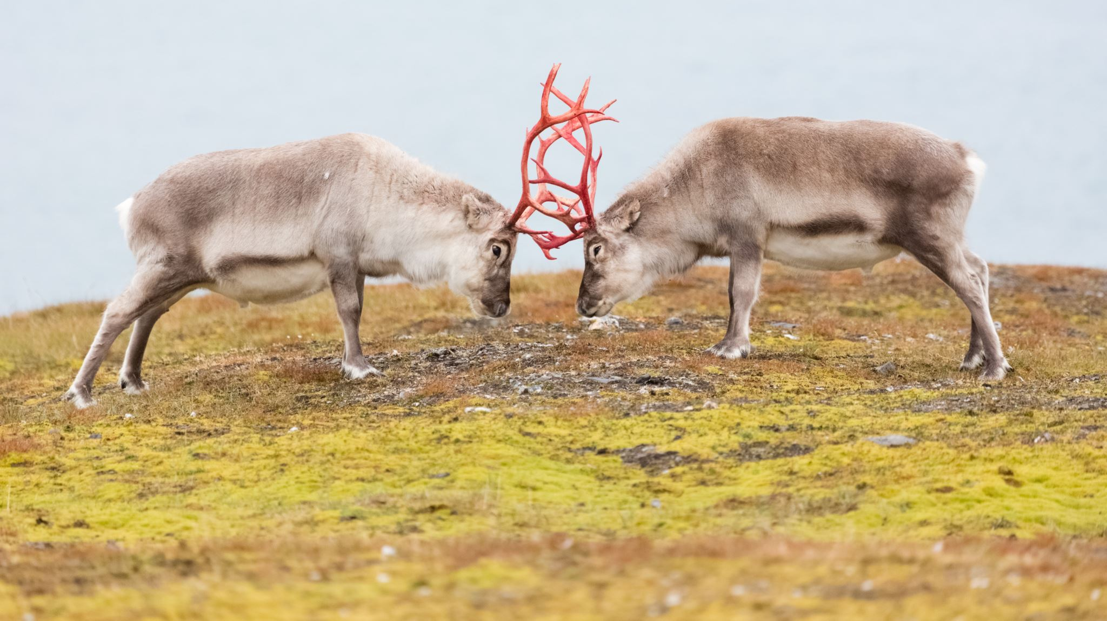
Conflict
Not inherently bad/evil
“A difference of opinion or purpose that frustrates someone’s goals or desires”
Misunderstanding (Joshua 22:10-34)
Differences in goals/expectations (Acts 15:39)
Competition (Gen 13:1-12)
Sinful Behavior/Attitudes (James 4:1-2)
Desire unity, not uniformity.
Conflict gives us a chance to glorify God, serve others, and grow.

Slide 3
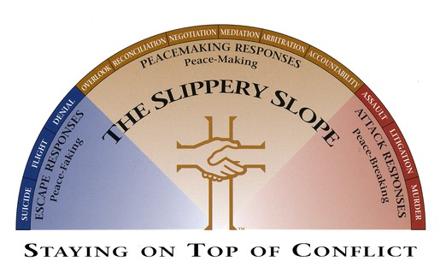

Slide 4
4 G’s of Biblical Peacemaking
Glorify God
Get the Log Out
Gently Restore
Go and Be Reconciled

