Slide 2
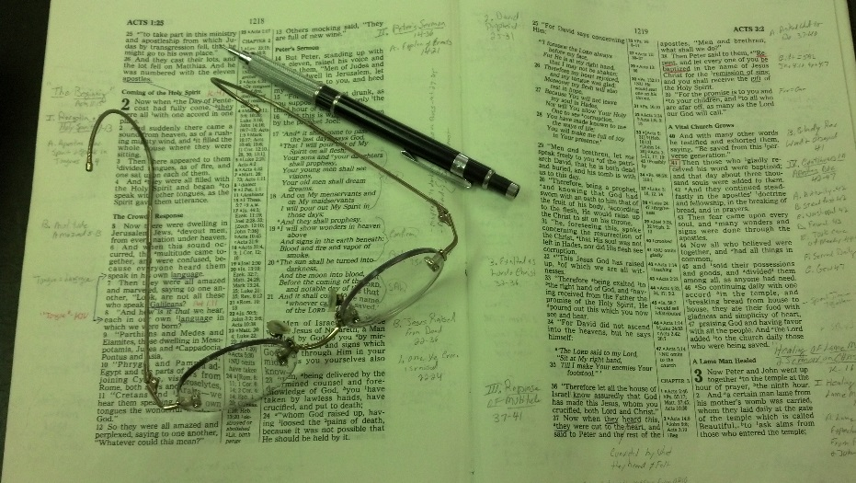
Topics
Monday: Blood of Christ
Tuesday: Selling and Stirring
Wednesday: The Seduction of Joseph
Thursday: The Conversion of 3,000
Friday: Don’t Stop, Keep Walking

Slide 3
A Common Sin that is Seldom Acknowledged
Bitterness
May Otherwise Be:
Doctrinally Sound
Faithful in attendance
Knowledgeable in the Word
Active in the church

Slide 4
Bible Addresses the Problem of
Bitterness
Ephesians 4:31
“Let all bitterness, wrath, anger, clamor, and evil speaking be put away from you, with all malice.”

Slide 5
Bible Addresses the Problem of
Bitterness
Colossians 3:19
“Husbands, love your wives and do not be bitter toward them.”

Slide 6
Bible Addresses the Problem of
Bitterness
Hebrews 12:15
“looking carefully lest anyone fall short of the grace of God; lest any root of bitterness springing up cause trouble, and by this many become defiled”

Slide 7
Bible Addresses the Problem of
Bitterness
James 3:14
“But if you have bitter envy and self-seeking in your hearts, do not boast and lie against the truth.”

Slide 8
Since the Bible talks about it
I need to learn what it is
and what God says about it
What causes it?
What is the problem with it?
How do I get over it?
Am I guilty?
Ephesians 4:31
“Let all bitterness, wrath, anger, clamor, and evil speaking be put away from you, with all malice.”
Colossians 3:19
“Husbands, love your wives and do not be bitter toward them.”
Hebrews 12:15
“looking carefully lest anyone fall short of the grace of God; lest any root of bitterness springing up cause trouble, and by this many become defiled”
James 3:14
“But if you have bitter envy and self-seeking in your hearts, do not boast and lie against the truth.”

Slide 9
Bitterness

Slide 10
Bitterness
Its Meaning

Slide 11
Its Meaning
Comes from pikria
BDAG: “State of being bitter in an affective sense, bitterness, animosity, anger, harshness.” (813)
Swanson: “bitter resentment”
Thayer: “Bitter hatred” (Eph.4:31); “bitterness of speech” (Rom. 3:14)
Barclay: “The Greeks defined this word as long-standing resentment, the spirit which refuses to be reconciled (183)
TDNT (Kittel): Originally pointed or sharp, i.e. arrows; later to “shrill” of noise, then to bitter or sharp taste.

Slide 12
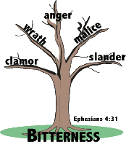
Its Meaning
Comes from pikria
It is hatred
Animosity & resentment is hatred
Lack of love = hatred (1 John 3:15)
Closely related to wrath, malice, anger, etc. (Eph. 4:31)

Slide 13
Bitterness
Its Meaning
Its Causes

Slide 14
Its Causes
Immaturity
The Corinthians had harsh feelings toward one another – were immature (1 Cor. 3:1-4)
To love even your enemies is to be “perfect” (complete, mature) (Matt. 5:44-48)
A person who hasn’t grown and developed spiritually – more likely to become bitter

Slide 15
Its Causes
Immaturity
Lacking in Wisdom
Prov. 10:18
It is part of wisdom from below (Jas. 3:13-18)
A person who doesn’t seek or use wisdom – is likely to become bitter

Slide 16
Its Causes
Immaturity
Lacking in Wisdom
Pride
Simon was poisoned by bitterness (Acts 8:23)
Translated: “full of bitter jealousy” (NCV)
Thinking only of self (Envious - very envious)
By asking for the miraculous gift – shows a desire of recognition!
When one is filled with pride (thinking only about self) likely to become bitter!

Slide 17
Its Causes
Immaturity
Lacking in Wisdom
Pride
Lacking in Love
Contrast of love and being embittered (Col. 3:19)
Love is the opposite of hate
One who is bitter and resentful – don’t know or practice love!

Slide 18
Its Causes
Immaturity
Lacking in Wisdom
Pride
Lacking in Love
Never Put off the Old Man
Bitterness is part of the old man (Eph. 4:22-32)
One who is bitter has kept the old man of sin alive – never put him off! – Living like the world!

Slide 19
Its Causes
Immaturity
Lacking in Wisdom
Pride
Lacking in Love
Never Put off the Old Man
Listen to the Wrong Source of Guidance
Wisdom from above would not point you toward bitterness (Jas 3:13-18)
Wisdom from the wrong source – feeds and strokes your anger, resentment, and hatred!
When you get advice from the world – listen to the wrong people – don’t be surprise if your bitterness doesn’t grow!

Slide 20
Its Causes
Immaturity
Lacking in Wisdom
Pride
Lacking in Love
Never Put off the Old Man
Listen to the Wrong Source of Guidance

Slide 21
Bitterness
Its Meaning
Its Causes
Its Danger

Slide 22
Its Danger
Not Easily Detected
Pictured as a root (Heb. 12:15; cf. Deut. 29:18)
Not seen on surface – but see what it feeds
Bitter plant that grows among the good
The wrong done to makes one feel justified in harboring resentment – thus don’t see the bitterness
Possible that the bitter one doesn’t see himself as bitter!

Slide 23
Its Danger
Not Easily Detected
Stirs Turmoil
Prov. 10:12
Lead to other sins that are turbulent (Jas. 3:14-16)
Bitterness can cause us to make trouble out of something that we would tolerate in someone we liked!

Slide 24
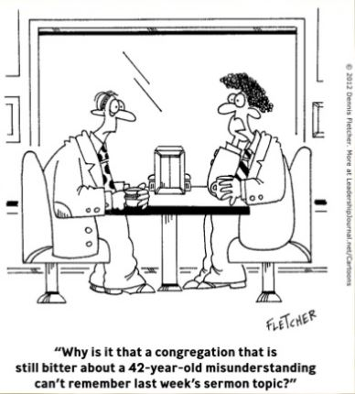

Slide 25
Its Danger
Not Easily Detected
Stirs Turmoil
Causes Us to Say Cutting Words
Mouth reflects our bitterness (Rom. 3:14; cf. Psa. 10:7)
Hatred is cruel (Psa. 25:19)
Words of hatred (Psa. 109:3)
Our bitterness is what drives the cutting and stinging words we let fly!

Slide 26
Its Danger
Not Easily Detected
Stirs Turmoil
Causes Us to Say Cutting Words
Robs You of Your Happiness
Bitterness makes you miserable
Never see a bitter person who is happy
Prov. 15:17

Slide 27
Its Danger
Not Easily Detected
Stirs Turmoil
Causes Us to Say Cutting Words
Robs You of Your Happiness
Destroys You
Heb. 12:15
Becomes your master – it enslaves & controls you
Not always what you eat that destroys you – it was eats at you!
R. Nixon: “Others may hate you, but those that hate you don’t win – unless you hate them. And then, you destroy yourself.”

Slide 28
Bitterness is like drinking poison and hoping it will hurt someone else.

Slide 29
Its Danger
Not Easily Detected
Stirs Turmoil
Causes Us to Say Cutting Words
Robs You of Your Happiness
Destroys You

Slide 30
Bitterness
Its Meaning
Its Causes
Its Danger
Its Sinfulness

Slide 31
Its Sinfulness
It is Sinful
It is of the old man (Eph. 4:31)
It is of the devil (Jas. 3:14)
It is hatred (Col. 3:19)

Slide 32
Its Sinfulness
It is Sinful
Commanded to Put it Away
Old man to be put away (Eph. 4:31)
Put away hatred by the grace of God (Titus 3:1-7)

Slide 33
Its Sinfulness
It is Sinful
Commanded to Put it Away
Conclusion:
Can’t please the Lord with bitterness
Can’t go to heaven with bitterness
As deep as it runs, and as long as it may last – it can be put away!

Slide 34
Its Sinfulness
It is Sinful
Commanded to Put it Away
Conclusion:

Slide 35
Bitterness
Its Meaning
Its Causes
Its Danger
Its Sinfulness
Its Answer & Cure

Slide 36
Its Answer & Cure
Realize it is Sinful – Thus Must Change
Ephesians 4:31
“Let all bitterness, wrath, anger, clamor, and evil speaking be put away from you, with all malice.”
Colossians 3:19
“Husbands, love your wives and do not be bitter toward them.”
Hebrews 12:15
“looking carefully lest anyone fall short of the grace of God; lest any root of bitterness springing up cause trouble, and by this many become defiled”
James 3:14
“But if you have bitter envy and self-seeking in your hearts, do not boast and lie against the truth.”

Slide 37
Its Answer & Cure
Realize it is Sinful – Thus Must Change
Pray
For strength to overcome (Phil. 4:13)
For wisdom (Jas. 1:5)
For the person for whom you harbor bitterness (Matt. 5:44)

Slide 38
Its Answer & Cure
Realize it is Sinful – Thus Must Change
Pray
Try to Understand the Person You Resent
Phil. 2:4 – think about the other person
Matt. 7:12 – treat him the way want to be
1 Cor. 13:7 – give the benefit of the doubt

Slide 39
Its Answer & Cure
Realize it is Sinful – Thus Must Change
Pray
Try to Understand the Person You Resent
Learn to Love
Love in commanded & expected (Heb. 13:1)
Love even our enemies (Matt. 5:44)
Love will do (1 Cor. 13:1-ff)
Love can be learned!

Slide 40
Its Answer & Cure
Realize it is Sinful – Thus Must Change
Pray
Try to Understand the Person You Resent
Learn to Love

Slide 41
Bitterness
Its Meaning
Its Causes
Its Danger
Its Sinfulness
Its Answer & Cure

