Slide 2
One God, Three Persons
A study of the trinity

Slide 3
Introduction
What is the Trinity?
Only one God, but He exists in three distinct persons, each equal in divine nature: Father, Son, Holy Spirit
United under one “name” (i.e. Yahweh)
“…baptizing them in the name of the Father and the Son and the Holy Spirit…” (Matthew 28:19)

Slide 4
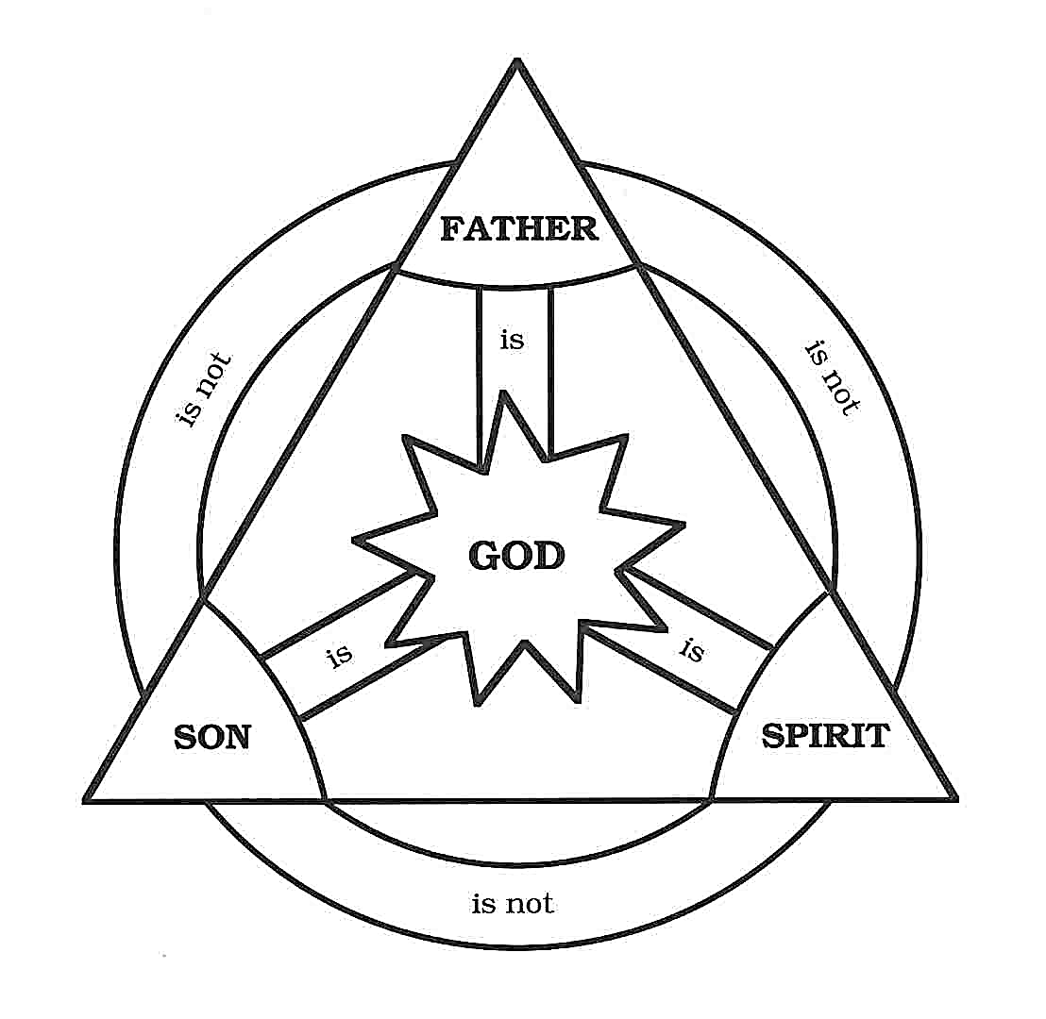

Slide 5
Introduction
What is the Trinity?
Why is the Trinity important?
Gives God His due honor (Jesus & Holy Spirit)
This is the foundation of the gospel’s authority
“…baptizing them in the name of the Father and the Son and the Holy Spirit…” (Matthew 28:19)

Slide 6
Introduction
What is the Trinity?
Why is the Trinity important?
Can we understand the Trinity?
No perfect analogy
The question is not, “Can we fully understand it?” but, “Does the Bible teach it?”

Slide 7
Roadmap: Three “Steps”
There is only one God
The Father, Son, and Holy Spirit are equally God
While one, these three are distinct Persons

Slide 8
There is Only One God
Affirmed throughout the Bible
Deuteronomy 6:4; Ephesians 4:6
Worshipping any other God is condemned
Exodus 20:3; Romans 1:22-23
The Trinity is not “three gods”
Old Testament hints at God’s plurality
“Us” (Genesis 1:26-27; 3:22; 11:7)

Slide 9
These Three are Equally God
The Father
1 Corinthians 1:3; Ephesians 4:6
Jesus the Son
John 1:1-3; 10:33; 8:58; 20:28-29
“Fullness of deity”—Colossians 2:9
The Holy Spirit
Acts 5:3-4
Qualities of deity—Hebrews 9:14; Psalm 139:7

Slide 10
These Three are Distinct
Three separate persons
Matthew 3:16-17; John 14:16
Equal in nature, but different in role
Jesus: submissive but equal to Father (John 14:28; 5:18)
Three involved in accomplishing salvation
Father planned (Ephesians 1:3-4)
Jesus sacrificed (Ephesians 1:7)
Holy Spirit sealed (Ephesians 1:13)

Slide 11
Conclusion
If there is only one God and the three are spoken of as equally God while distinct persons, what other conclusion can we draw than the Trinity?

Slide 12
How Should This Change Me?
Cause us to worship God as deserving all honor (Revelation 5:11-14)
Teach us to strive for unity among brethren (John 17:21, 23)
Solidify our faith in Jesus our God and Savior (John 20:30-31)

