Slide 2
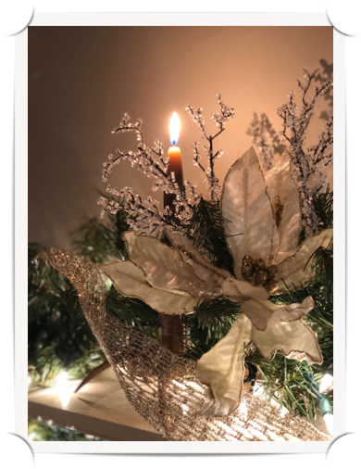

Why Did Jesus Come?
“And an angel of the Lord stood by them, and the glory of the Lord shone round about them: and they were sore afraid. And the angel said unto them, Be not afraid; for behold, I bring you good tidings of great joy which shall be to all the people: for there is born to you this day in the city of David a Savior, who is Christ the Lord” (Luke 2:9-11).

Slide 3
Why Did Jesus Come?
“For unto us a child is born, unto us a son is given; and the government shall be upon his shoulder: and his name shall be called Wonderful, Counsellor, Mighty God, Everlasting Father, Prince of Peace. Of the increase of his government and of peace there shall be no end, upon the throne of David, and upon his kingdom, to establish it, and to uphold it with justice and with righteousness from henceforth even for ever” (Is. 9:6-7).

Slide 4
Why Did Jesus Come?
“And she shall bring forth a son; and thou shalt call his name JESUS; for it is he that shall save his people from their sins” (Mt. 1:21).

Slide 5
Why Did Jesus Come?
“For God so loved the world, that he gave his only begotten Son, that whosoever believe on Him should not perish, but have eternal life. For God sent not the Son into the world to judge the world; but that the world should be saved through Him” (Jn. 3:16-17).

Slide 6

Why Jesus Came…
In His Own Words

Slide 7
Why Jesus Came…
In His Own Words
“I have come down from heaven, not to do My own will, but the will of Him who sent Me” (John 6:38).
“…I did not come to call the righteous, but sinners” (Mark 2:17).
“For the Son of Man has come to seek and to save the which was lost” (Luke 19:10).

Slide 8
Why Jesus Came…
In His Own Words
“…I will build My church; and the gates of Hades will not overpower it” (Mt. 16:18).
“Now My soul has become troubled; and what shall I say, ‘Father save Me from this hour? But for this purpose I came to this hour” (John 12:27).
“I have come as Light into the world, so that everyone who believes in Me will not re. main in darkness. If anyone hears My sayings and does not keep them, I do not judge him; for I did not come to judge the world, but to save the world” (Jn. 12:46-47).
“I came that they might have life, and have it abundantly” (Jn. 10:10).

Slide 9
Why Jesus Came…
In His Own Words
“I have come as Light into the world, so that everyone who believes in Me will not re. main in darkness. If anyone hears My sayings and does not keep them, I do not judge him; for I did not come to judge the world, but to save the world. He who rejects Me and does not receive My sayings, has one who judges him; the word I spoke is what will judge him at the last day” (John 12:46-49).

Slide 10
Why Jesus Came…
What is Your Answer?

