Slide 2
THE BIBLE
in thirty minutes

Slide 3
Numbers of the Bible
66 – independent writings
1500 – years in the making
40 – authors
3 – languages
1 – amazing story

Slide 4
What’s In the Bible?

Slide 5
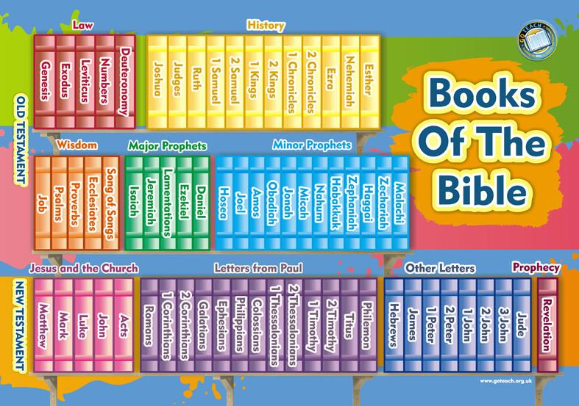
Jewish Nation
2 testaments (“covenant relationship”)
All Nations

Slide 6
HISTORICAL
God and humanity (Gen. 1-11)
God and Israel (Gen. 12-Esther)
God to Abraham: “…And in you all the nations of the earth will be blessed!” (Genesis 12:3)

Slide 7
DEVOTIONAL
Suffering
Worship
Wisdom
Marriage

Slide 8
PROPHETIC
Messages from God…
About the present
About the future
“He was pierced because of our rebellion,
Crushed because of our iniquities;
Punishment for our peace was upon him,
And we are healed by his wounds.”
(Isaiah 53:5, CSB)

Slide 9
Jesus to apostles: “All authority has been given to me in heaven and on earth. Go therefore and make disciples of all the nations, baptizing them in the name of the Father and the Son and the Holy Spirit.” (Matthew 28:19)
HISTORICAL
4 Gospels – Jesus’ life as the Son of God

Slide 10
HISTORICAL
4 Gospels – Jesus’ life as the Son of God
Acts – spread of gospel and the church

Slide 11
DEVOTIONAL
How to live as a follower of Jesus
Timeless doctrines and duties of a Christian

Slide 12
PROPHETIC
Symbolism and pictures
Hope thru persecution
A glorious future for God’s people!

Slide 13
JESUS CONCEALED
JESUS REVEALED

Slide 14
What’s The Bible’s Message?
“But know this first of all, No prophecy of Scripture is a matter of one’s own interpretation, for no prophecy was ever made by an act of human will, but men moved by the Holy Spirit spoke from God.” (2 Peter 1:20-21)

Slide 15
The Key to the Bible
Luke 24:44-47 – JESUS is the key!
Jesus’ suffering and death
Jesus’ resurrection
Repentance toward Jesus
Salvation of sins through Jesus

Slide 16
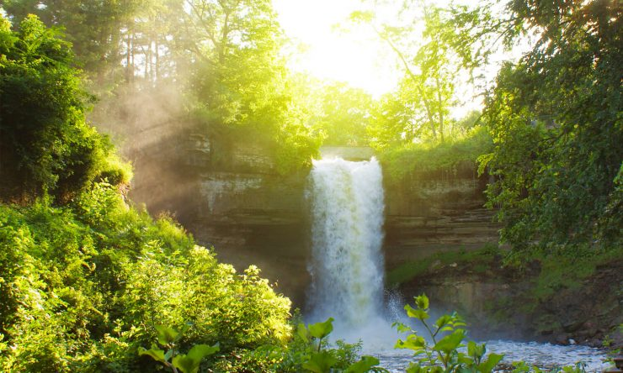
The Beginning
God created a Garden (Genesis 1-2)
Adam / Eve cast out of the Garden (Gen. 3)
Will God ever allow people into the Garden again?

Slide 17
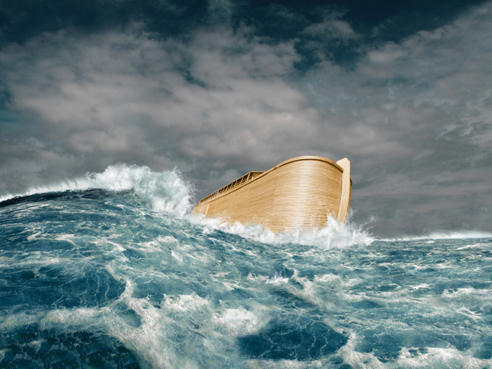
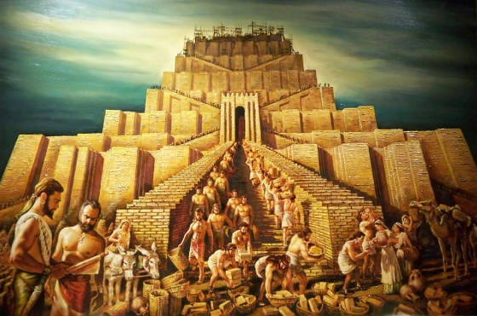
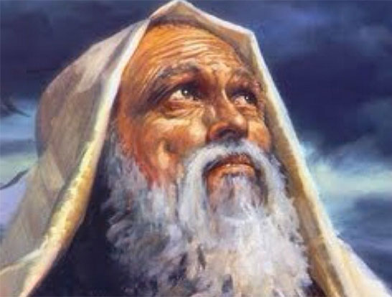
Sin Spreads

Slide 18
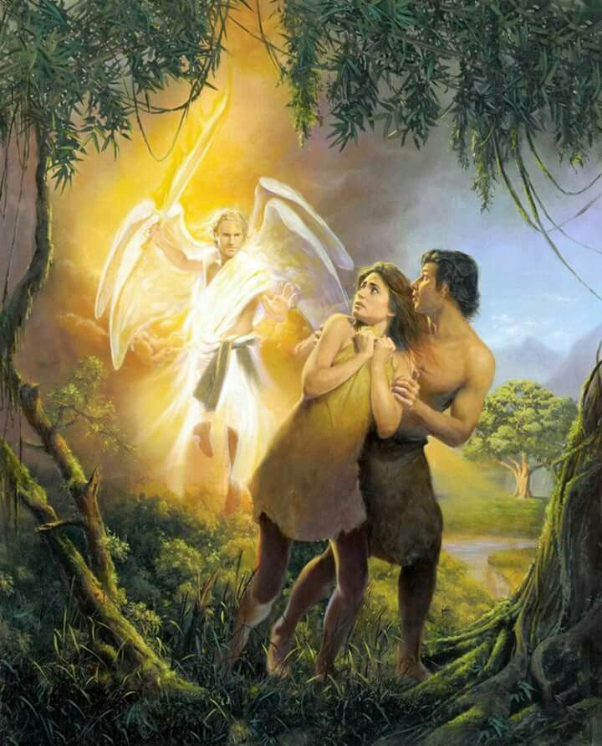
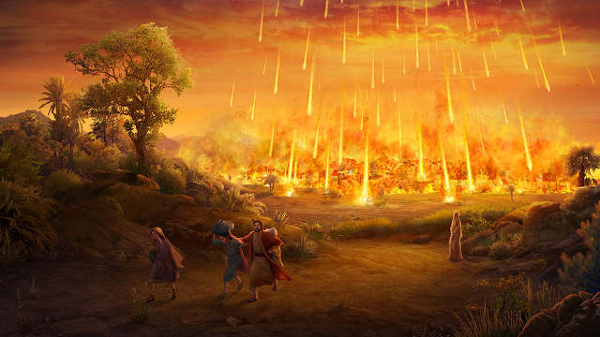
God Is Holy (Isaiah 6:3)
Holy, Holy, Holy is the LORD of hosts,
The whole earth is full of His glory!
The wages of sin is death… (Rom. 6:23)

Slide 19
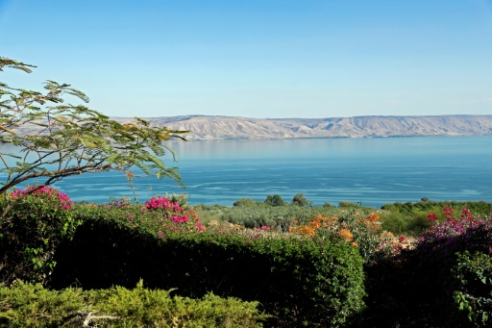
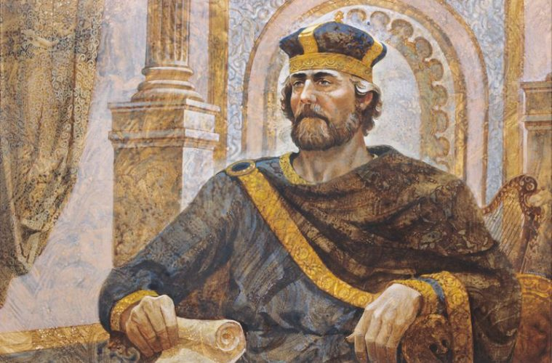
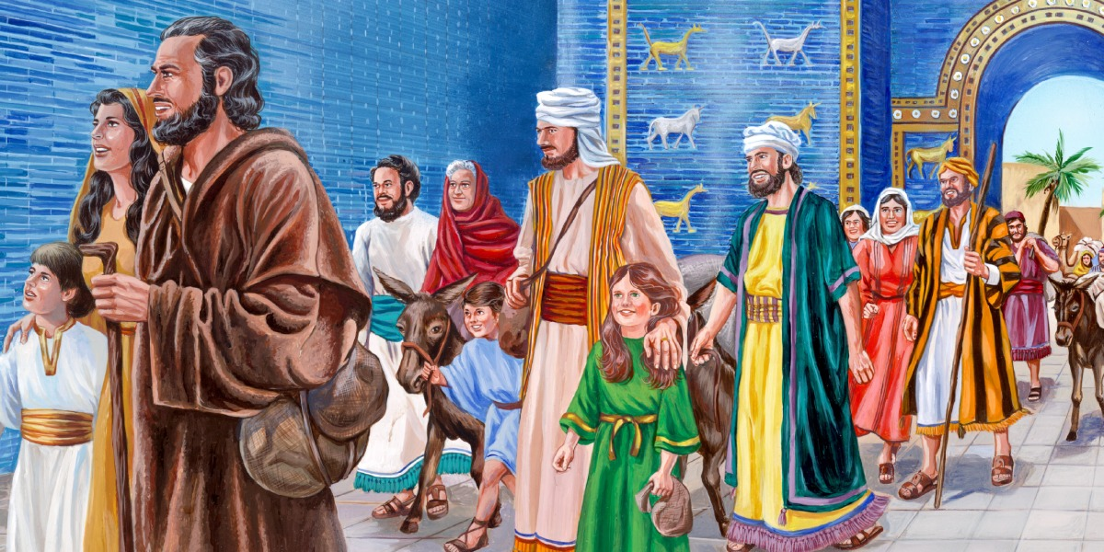
God Is Love (1 John 4:8)
The one who does not love does not know God, for God is love.

Slide 20
Jesus Revealed
Luke 24:44-47
WHY – we have sinned (Romans 3:23)
WHAT – Jesus died for our sins (1 Corinthians 15:3-4)
HOW – forgiveness received through repentance and baptism (Acts 2:38)

Slide 21
Revelation 22:1-4
River
Tree of Life
Curse Undone
See God’s face
God invites you into His garden!

