Slide 2
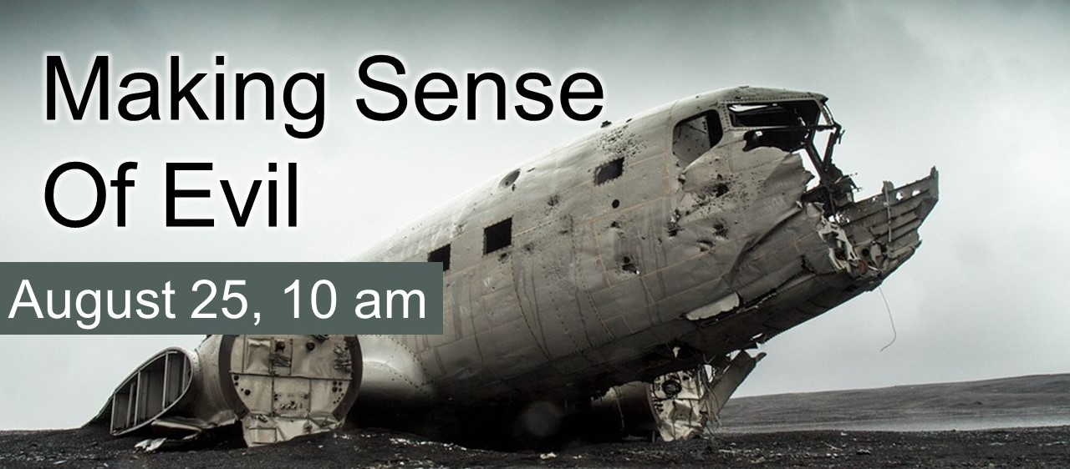

Slide 3
The Text of the Old Testament

Slide 4
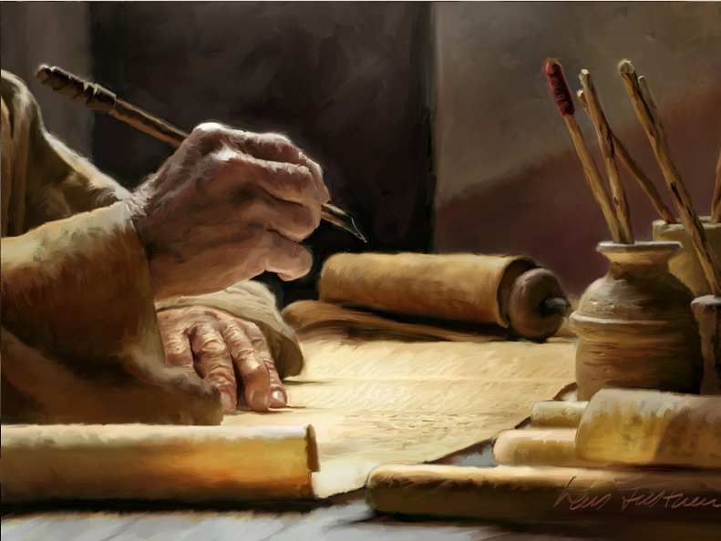
The Masoretic Text
Scriptures copied and preserved by scribes
Ezra 7:6, 10
Luke 10:25f
The Masorete scribes
AD 500-1000
From “masora” (tradition)
Goal – faithfully preserve the tradition of the text in Jesus’ day

Slide 5
The Masoretic Text
Reverence for text – meticulous attention to detail
Included line, verse, word, letter counts as quality control
1534 verses in Genesis
5845 verses / 79,856 words / 400,945 letters in Torah

Slide 6
The Masoretic Text
Reverence for text – meticulous attention to detail
Included line, verse, word, letter counts as quality control
Perfected a vowel system to preserve proper pronunciation

Slide 7
This was not viewed as changing or adding to the text – only preserving the pronunciation for non-speakers of Hebrew

Slide 8
lv th Lrd yr Gd wth ll yr hrt
(Deuteronomy 6:5)

Slide 9
The Masoretic Text
Meticulous, attention to detail, reverence for the text
Line, verse, word, letter counts included as quality control
A vowel-point system to preserve proper pronunciation
Destroyed worn-out and erroneous copies
Result: Masoretic Text
9th – 11th century AD
Basis for our English translations

Slide 10
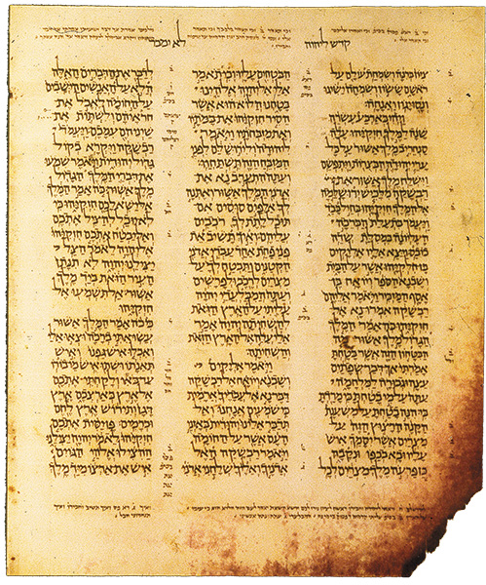
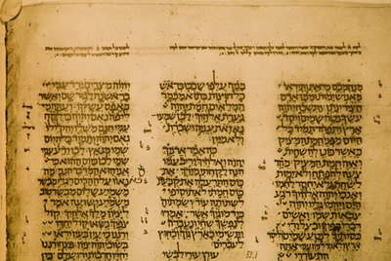
Leningrad Codex – AD 1008
oldest complete copy of OT
Aleppo Codex – AD 925
most authoritative copy of OT

Slide 11
The Septuagint
History: translation of the Hebrew OT into Greek
Begun 250 BC in Alexandria by 70 Jewish scholars
From Latin word for 70 – LXX
Use: widely used in 1st century AD
Version most often quoted in the NT
Acts 17:2-3; 18:27-28
Validates the use of translations today!

Slide 12
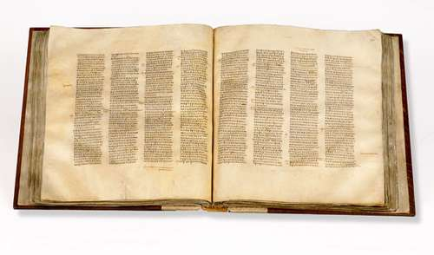
The Septuagint
Existing texts date to 4th century AD
Codex Sinaiticus (AD 350)
We can reconstruct (in a limited way) the original Hebrew text used by the translators
Comparison with the Masoretic Text (AD 1000) shows close resemblance
This takes us 600 years closer to the originals, but we can go further…

Slide 13
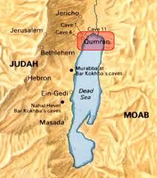
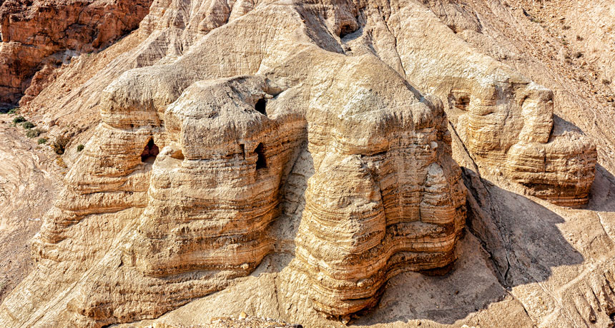
The Dead Sea Scrolls

Slide 14
The Dead Sea Scrolls
1947 – 190 fragments of the OT discovered
Undisturbed for 2000 years
Fragments of every OT book, except Esther
Some date to 3rd century BC
“Isaiah B” is 95% identical to the MT of 1300 years later!
Of the 166 words in Isaiah 53, there are only 17 letters in question. Ten are simply a matter of spelling, not affecting the sense. Four letters are minor stylistic changes. The remaining three letters comprise the word “light” in v. 11, and does not affect the meaning greatly. (Burrows, The Dead Sea Scrolls p. 304)

Slide 15
The Dead Sea Scrolls
Significance:
“Greatest archaeological find in modern history” (Albright)
Forges an unbroken chain of textual preservation for 1300+ years!
Proves the accuracy of the long-accepted Masoretic Text
Accidental or providential?

Slide 16
Conclusion
Archaeology demonstrates we can have confidence in the faithful preservation of the Old Testament
Jesus believed in the faithful preservation of the Old Testament (Luke 24:44-45)
Our faith in Scripture rests on the resurrected Son of God!

